Slide 1
RSS Feed
What is it?
RSS is short for Really Simple Syndication.
An RSS Feed is basically a computer-readable summary of the content of a Web page. It is a format for delivering web content of a website that changes regularly.
RSS is also known as RFD.

Slide 2

What does it look like?

Slide 3
How do I subscribe to an RSS feed?
First, you need an RSS Reader or an RSS Aggregator, which is basically a program that knows how to read and keep track of your RSS feeds. You can have stand-alone apps or web-based readers. Web-based readers are better since they can give your RSS feeds on any computer or browser, anywhere. They include Google Reader, Feedlooks, Netvibes, My Yahoo, and many more. Mac OS X already has an RSS reader pre-installed (NetNewsWire). Some standalone readers are Sharpreader or Liferea.

Slide 4
Continued
After installing or signing up for the RSS reader of your choice, you simply search for different RSS feeds of your interest.
With a particular feed in mind, like the Stuy CS hw page, you click the “subscribe to posts / RSS” link. This will take you to an XML page. Just copy the URL on top and paste it to your RSS reader’s designated place. Now, you are subscribed to the RSS Feed for Mr. Brown’s CS HWs.
SUCCESS!!!!!!!!!!!

Slide 5
Benefit?
The benefits of subscribing to an RSS feed from a site is that you no longer need to visit the site itself to stay up-to-date on what's being discussed. Are you going to pop over to the site every day? I doubt it, especially a month from now.
Subscribe to the RSS feed, though, and your RSS Reader will do all the work, showing you only what's new since the last time you've checked the RSS feed. And that's the real value of RSS: to be able to stay current with dozens or even hundreds of Web sites, quickly and efficiently.

Slide 6
Alternative?
If RSS feed is too irksome to imagine, it might be easier to use an email based subscription.
You would receive emails every time the site is updated, and can cancel your subscription anytime.

Slide 7
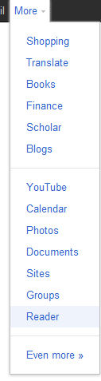
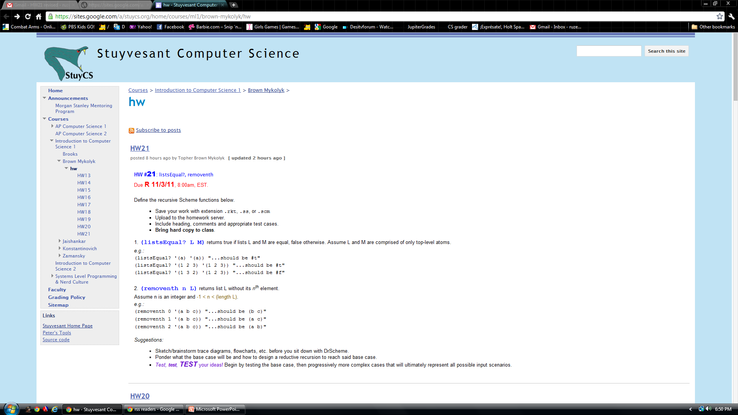
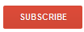
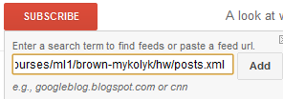
Google Reader How-To
Sign in to GMAIL
Search for {Google Reader} on Google, press [I’m Feeling Lucky]
Alternatively to step two, press the “More” tab, and then
click on “Reader”.
Open another tab and go to https://sites.google.com/a/stuycs.org/home/courses/ml1/brown-mykolyk/hw (or any RSS applicable site)
Click on
Copy the URL found at the top of the browser. https://sites.google.com/a/stuycs.org/home/courses/ml1/brown-mykolyk/hw/posts.xml (has to have .xml)
Go back to the first tab and click on
Paste the URL in the box and click ADD
Now you have regular updates of the CS HW without having to go the website itself and check for any updates.

